Slide 1
Decision Making Under Uncertainty
Russell and Norvig: ch 16, 17

Slide 2
Utility-Based Agent
sensors
?
environment
agent
actuators

Slide 3
Non-deterministic vs. Probabilistic Uncertainty
?
?
a
b
c
a
b
c
{a,b,c}
decision that is
best for worst case
{a(pa),b(pb),c(pc)}
decision that maximizes
expected utility value
Non-deterministic model
Probabilistic model
~ Adversarial search

Slide 4
Expected Utility
Random variable X with n values x₁,…,x_{n} and distribution (p₁,…,p_{n})
E.g.: X is the state reached after doing an action A under uncertainty
Function U of X
E.g., U is the utility of a state
The expected utility of A is
EU[A] = Σ_{i=1,…,n} p(x_{i}|A)U(x_{i})

Slide 5
One State/One Action Example
s0
EU(A1) = 100 x 0.2 + 50 x 0.7 + 70 x 0.1
= 20 + 35 + 7
= 62
A1
s1
s2
s3
0.2
0.7
0.1
100
50
70

Slide 6
One State/Two Actions Example
s0
EU(AI) = 62
EU(A2) = 74
EU(S0) = max{EU(A1),EU(A2)}
= 74
A1
A2
s1
s2
s3
s4
0.2
0.7
0.2
0.1
0.8
100
50
70
80

Slide 7
Introducing Action Costs
s0
EU(A1) = 62 – 5 = 57
EU(A2) = 74 – 25 = 49
EU(S0) = max{EU(A1),EU(A2)}
= 57
A1
A2
-5
-25
s1
s2
s3
s4
0.2
0.7
0.2
0.1
0.8
100
50
70
80

Slide 8
MEU Principle
rational agent should choose the action that maximizes agent’s expected utility
this is the basis of the field of decision theory
normative criterion for rational choice of action
AI is solved !!!

Slide 9
Not quite…
Must have complete model of:
  Actions
  Utilities
  States
Even if you have a complete model, will be computationally intractable
In fact, a truly rational agent takes into account the utility of reasoning as well---bounded rationality
Nevertheless, great progress has been made in this area recently, and we are able to solve much more complex decision theoretic problems than ever before

Slide 10
We’ll look at
Decision Theoretic Planning
  Simple decision making (ch. 16)
  Sequential decision making (ch. 17)

Slide 11
Decision Networks
Extend BNs to handle actions and utilities
Also called Influence diagrams
Make use of BN inference
Can do Value of Information calculations

Slide 12
Decision Networks cont.
Chance nodes: random variables, as in BNs
Decision nodes: actions that decision maker can take
Utility/value nodes: the utility of the outcome state.

Slide 13
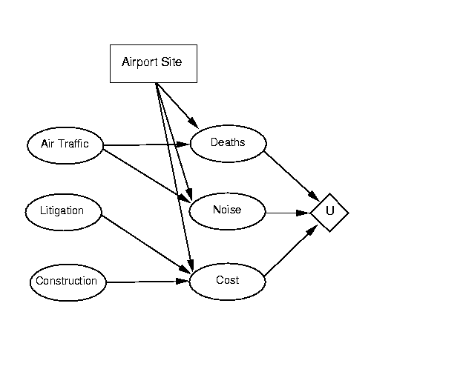
R&N example

Slide 14
Umbrella Network
take/don’t take
P(rain) = 0.4
Take Umbrella
rain
umbrella
P(umb|take) = 1.0
P(~umb|~take)=1.0
happiness
U(~umb, ~rain) = 100
U(~umb, rain) = -100
U(umb,~rain) = 0
U(umb,rain) = -25

Slide 15
Evaluating Decision Networks
Set the evidence variables for current state
For each possible value of the decision node:
  Set decision node to that value
  Calculate the posterior probability of the parent nodes of the utility node, using BN inference
  Calculate the resulting utility for action
return the action with the highest utility

Slide 16
Umbrella Network
take/don’t take
P(rain) = 0.4
Take Umbrella
rain
umbrella
#1
P(umb|take) = 1.0
P(~umb|~take)=1.0
umb | rain | P(umb,rain | take)
0 | 0 | 0
0 | 1 | 0
1 | 0 | 0.6
1 | 1 | 0.4
happiness
U(~umb, ~rain) = 100
U(~umb, rain) = -100
U(umb,~rain) = 0
U(umb,rain) = -25
#1: EU(take) = -10

Slide 17
Umbrella Network
take/don’t take
P(rain) = 0.4
Take Umbrella
rain
umbrella
#2
P(umb|take) = 1.0
P(~umb|~take)=1.0
umb | rain | P(umb,rain | ~take)
0 | 0 | 0.6
0 | 1 | 0.4
1 | 0 | 0
1 | 1 | 0
happiness
U(~umb, ~rain) = 100
U(~umb, rain) = -100
U(umb,~rain) = 0
U(umb,rain) = -25
#2: EU(~take) = 20

Slide 18
Making Decision
Choose the action with the highest utility
#1: EU(take) = -10
#2: EU(~take) = 20
Therefore : The decision is ~take.

Slide 19
Value of Perfect Information (VPI)
How much is it worth to observe (with certainty) a random variable X?
  Suppose the agent’s current knowledge is E. The value of the current best action α is:
  EU(α | E) = max_{A} ∑_{i} U(Result_{i}(A)) p(Result_{i}(A) | E, Do(A))
  The value of the new best action after observing the value of X is:
  EU(α’ | E,X) = max_{A} ∑_{i} U(Result_{i}(A)) p(Result_{i}(A) | E, X, Do(A))
…But we don’t know the value of X yet, so we have to sum over its possible values
The value of perfect information for X is therefore:
VPI(X) = ( ∑_{k} p(x_{k} | E) EU(α_{xk} | x_{k}, E)) – EU (α | E)
Expected utility
of the best action
if we don’t know X
(i.e., currently)
Probability of
each value of X
Expected utility
of the best action
given that value of X

Slide 20
Umbrella Network
take/don’t take
P(rain) = 0.4
Take Umbrella
rain
umbrella
P(umb|take) = 1.0
P(~umb|~take)=1.0
forecast
happiness
R | F | P(F|R)
0 | 0 | 0.8
0 | 1 | 0.2
1 | 0 | 0.3
1 | 1 | 0.7
U(~umb, ~rain) = 100
U(~umb, rain) = -100
U(umb,~rain) = 0
U(umb,rain) = -25

Slide 21
Evidence P(R|F)
Find P(F)
P(F=Rainy) = P(F=Rainy|R=Rain)P(R=Rain) + P(F=Rainy|R=~Rain)P(R=~Rain)
P(F=1) = P(F=1|R=1)P(R=1) + P(F=1|R=0)P(R=0)
= (0.7) (0.4) + (0.2) (0.6) = 0.28 + 0.12 = 0.4
P(F=~Rainy) = P(F=~Rainy|R=Rain)P(R=Rain) + P(F=~Rainy|R=~Rain)P(R=~Rain)
P(F=0) = P(F=0|R=1)P(R=1) + P(F=0|R=0)P(R=0)
= (0.3) (0.4) + (0.8) (0.6) = 0.12 + 0.48 = 0.6
Now, you can find P(R|F)
  P(R|F) = P(F|R)P(R)/P(F)
F | R | P(R|F)
0 | 0 | = (0.8)(0.6)/(0.6) = 0.8
0 | 1 | = (0.3)(0.4)/(0.6) = 0.2
1 | 0 | = (0.2)(0.6)/(0.4) = 0.3
1 | 1 | = (0.7)(0.4)/(0.4) = 0.7

Slide 22
Umbrella Network
P(F=rainy) = 0.4
F | R | P(R|F)
0 | 0 | 0.8
0 | 1 | 0.2
1 | 0 | 0.3
1 | 1 | 0.7
take/don’t take
P(rain) = 0.4
Take Umbrella
rain
umbrella
P(umb|take) = 1.0
P(~umb|~take)=1.0
forecast
happiness
R | F | P(F|R)
0 | 0 | 0.8
0 | 1 | 0.2
1 | 0 | 0.3
1 | 1 | 0.7
U(~umb, ~rain) = 100
U(~umb, rain) = -100
U(umb,~rain) = 0
U(umb,rain) = -25

Slide 23
umb | rain | P(umb,rain | take, rainy)
0 | 0 | 0
0 | 1 | 0
1 | 0 | 0.3
1 | 1 | 0.7
umb | rain | P(umb,rain | take, ~rainy)
0 | 0 | 0
0 | 1 | 0
1 | 0 | 0.8
1 | 1 | 0.2
#1: EU(take|rainy) = -17.5
#3: EU(take|~rainy) = -5
umb | rain | P(umb,rain | ~take, rainy)
0 | 0 | 0.3
0 | 1 | 0.7
1 | 0 | 0
1 | 1 | 0
umb | rain | P(umb,rain |~take, ~rainy)
0 | 0 | 0.8
0 | 1 | 0.2
1 | 0 | 0
1 | 1 | 0
#2: EU(~take|rainy) = -40
#4: EU(~take|~rainy) = 60

Slide 24




What is the optimal decision?
Forecast = ~Rain & Umbrella = ~take
  EU(~take|F=0) =
  (0.8)(100) + (0.2)(-100) = 60
Forecast = Rain & Umbrella = ~take
  EU(~take|F=1) =
  (0.3)(100) + (0.7)(-100) = -40
Forecast = ~Rain & Umbrella = take
  EU(take|F=0) =
  (0.8)(0) + (0.2)(-25) = -5
Forecast = Rain & Umbrella = take
  EU(take|F=1) =
  (0.3)(0) + (0.7)(-25) = -17.5

Slide 25
Optimal Decisions
No evidence
MEU() = max_{α} EU(α) = 20 α = ~take
If we have F=rainy
MEU(F=rainy) = max_{α} EU(α|F=rainy)
= -17.5 α = take
If we have F=~rainy
MEU(F=~rainy) = max_{α} EU(α|F=~rainy)
= 60 α = ~take

Slide 26
Umbrella Network
P(F=rainy) = 0.4
F | R | P(R|F)
0 | 0 | 0.8
0 | 1 | 0.2
1 | 0 | 0.3
1 | 1 | 0.7
take/don’t take
P(rain) = 0.4
Take Umbrella
rain
umbrella
P(umb|take) = 1.0
P(~umb|~take)=1.0
forecast
happiness
R | F | P(F|R)
0 | 0 | 0.8
0 | 1 | 0.2
1 | 0 | 0.3
1 | 1 | 0.7
U(~umb, ~rain) = 100
U(~umb, rain) = -100
U(umb,~rain) = 0
U(umb,rain) = -25

Slide 27
VPI (Value of Information)
VPI(forecast)=
P(F=rainy)EU(α_{F=rainy}) +
P(F=~rainy)EU(α_{F=~rainy}) –
EU(α)
  = (0.4)(-17.5) + (0.6)(60) – (20)
  = -7 + 36 – 20
  = 9

Slide 28
Sequential Decision Making
Finite Horizon
  there is a fixed time N
  So, with a finite horizon, the optimal action in a given state could change over time.
  We say that the optimal policy for a finite horizon is nonstationary.
Infinite Horizon
  With no fixed time limit
  the optimal action depends only on the current state
  the optimal policy is stationary.

Slide 29
Simple Robot Navigation Problem

Slide 30
Probabilistic Transition Model
In each state, the possible actions are U, D, R, and L
The effect of U is as follows (transition model):
  With probability 0.8 the robot moves up one square (if the
  robot is already in the top row, then it does not move)
  With probability 0.1 the robot moves right one square (if the
  robot is already in the rightmost row, then it does not move)
  With probability 0.1 the robot moves left one square (if the
  robot is already in the leftmost row, then it does not move)

Slide 31
Markov Property
The transition properties depend only
on the current state, not on previous
history (how that state was reached)

Slide 32
Sequence of Actions
[3,2]
3
2
1
1
2
3
4
Planned sequence of actions: (U, R)

Slide 33
Sequence of Actions
[3,2]
3
2
[3,2]
[3,3]
[4,2]
1
1
2
3
4
Planned sequence of actions: (U, R)
U is executed

Slide 34
Histories
[3,2]
3
2
[3,2]
[3,3]
[4,2]
1
[3,1]
[3,2]
[3,3]
[4,1]
[4,2]
[4,3]
1
2
3
4
Planned sequence of actions: (U, R)
U has been executed
R is executed
There are 9 possible sequences of states
– called histories – and 6 possible final states
for the robot!

Slide 35
Probability of Reaching the Goal
3
2
1
1
2
3
4
P([4,3] | (U,R).[3,2]) =
P([4,3] | R.[3,3]) x P([3,3] | U.[3,2])
+ P([4,3] | U.[4,2]) x P([4,2] | R.[3,2])
P([4,3] | R.[3,3]) = 0.8
P([4,3] | U.[4,2]) = 0.1
P([3,3] | U.[3,2]) = 0.8
P([4,2] | R.[3,2]) = 0.1
P([4,3] | (U,R).[3,2]) = (0.64 + 0.01) = 0.65

Slide 36
Utility Function
3
+1
2
-1
1
1
2
3
4
[4,3] provides power supply
[4,2] is a sand area from which the robot cannot escape

Slide 37
Utility Function
3
+1
2
-1
1
1
2
3
4
[4,3] provides power supply
[4,2] is a sand area from which the robot cannot escape
The robot needs to recharge its batteries

Slide 38
Utility Function
3
+1
2
-1
1
1
2
3
4
[4,3] provides power supply
[4,2] is a sand area from which the robot cannot escape
The robot needs to recharge its batteries
[4,3] or [4,2] are terminal states

Slide 39
Utility of a History
3
+1
2
-1
1
1
2
3
4
[4,3] provides power supply
[4,2] is a sand area from which the robot cannot escape
The robot needs to recharge its batteries
[4,3] or [4,2] are terminal states
The utility of a history is defined by the utility of the last
state (+1 or –1) minus n/25, where n is the number of moves

Slide 40
Utility of an Action Sequence
3
+1
2
-1
1
1
2
3
4
Consider the action sequence (U,R) from [3,2]

Slide 41
Utility of an Action Sequence
+1
[3,2]
3
2
-1
[3,2]
[3,3]
[4,2]
1
[3,1]
[3,2]
[3,3]
[4,1]
[4,2]
[4,3]
1
2
3
4
Consider the action sequence (U,R) from [3,2]
A run produces one among 7 possible histories, each with some
probability

Slide 42
Utility of an Action Sequence
+1
[3,2]
3
2
-1
[3,2]
[3,3]
[4,2]
1
[3,1]
[3,2]
[3,3]
[4,1]
[4,2]
[4,3]
1
2
3
4
Consider the action sequence (U,R) from [3,2]
A run produces one among 7 possible histories, each with some
probability
The utility of the sequence is the expected utility of the histories:
U = Σ_{h}U_{h} P(h)

Slide 43
Optimal Action Sequence
+1
[3,2]
3
2
-1
[3,2]
[3,3]
[4,2]
1
[3,1]
[3,2]
[3,3]
[4,1]
[4,2]
[4,3]
1
2
3
4
Consider the action sequence (U,R) from [3,2]
A run produces one among 7 possible histories, each with some
probability
The utility of the sequence is the expected utility of the histories
The optimal sequence is the one with maximal utility

Slide 44
Optimal Action Sequence
+1
[3,2]
3
2
-1
[3,2]
[3,3]
[4,2]
1
[3,1]
[3,2]
[3,3]
[4,1]
[4,2]
[4,3]
1
2
3
4
Consider the action sequence (U,R) from [3,2]
A run produces one among 7 possible histories, each with some
probability
The utility of the sequence is the expected utility of the histories
The optimal sequence is the one with maximal utility
But is the optimal action sequence what we want to
compute?
only if the sequence is executed blindly!

Slide 45
Reactive Agent Algorithm
Repeat:
s ← sensed state
If s is terminal then exit
a ← choose action (given s)
Perform a
Accessible or
observable state

Slide 46
Policy (Reactive/Closed-Loop Strategy)
3
+1
2
-1
1
1
2
3
4
A policy Π is a complete mapping from states to actions

Slide 47
Reactive Agent Algorithm
Repeat:
s ← sensed state
If s is terminal then exit
a ← Π(s)
Perform a

Slide 48
Optimal Policy
Note that [3,2] is a “dangerous”
state that the optimal policy
tries to avoid
3
+1
2
-1
1
1
2
3
4
A policy Π is a complete mapping from states to actions
The optimal policy Π* is the one that always yields a
history (ending at a terminal state) with maximal
expected utility
Makes sense because of Markov property

Slide 49
Optimal Policy
3
+1
2
-1
1
1
2
3
4
A policy Π is a complete mapping from states to actions
The optimal policy Π* is the one that always yields a
history with maximal expected utility
How to compute Π*?
This problem is called a
Markov Decision Problem (MDP)

Slide 50
Additive Utility
History H = (s₀,s₁,…,s_{n})
The utility of H is additive iff:
U(s₀,s₁,…,s_{n}) = R(0) + U(s₁,…,s_{n}) = Σ R(i)
Reward

Slide 51
Additive Utility
History H = (s₀,s₁,…,s_{n})
The utility of H is additive iff:
U(s₀,s₁,…,s_{n}) = R(0) + U(s₁,…,s_{n}) = Σ R(i)
Robot navigation example:
  R(n) = +1 if s_{n} = [4,3]
  R(n) = -1 if s_{n} = [4,2]
  R(i) = -1/25 if i = 0, …, n-1

Slide 52
Principle of Max Expected Utility
History H = (s₀,s₁,…,s_{n})
Utility of H: U(s₀,s₁,…,s_{n}) = Σ R(i)
First-step analysis →
U(i) = R(i) + max_{a} Σ_{k}P(k | a.i) U(k)
Π*(i) = arg max_{a} Σ_{k}P(k | a.i) U(k)
+1
-1

Slide 53
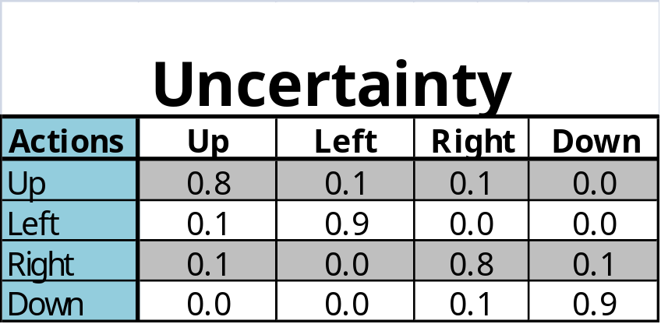
Value Iteration
Initialize the utility of each non-terminal state s_{i} to U₀(i) = 0
For t = 0, 1, 2, …, do:
U_{t+1}(i) ← R(i) + max_{a} Σ_{k}P(k | a.i) U_{t}(k)
3
+1
2
-1
1
1
2
3
4

Slide 54
Value Iteration
Note the importance
of terminal states and
connectivity of the
state-transition graph
Initialize the utility of each non-terminal state s_{i} to U₀(i) = 0
For t = 0, 1, 2, …, do:
U_{t+1}(i) ← R(i) + max_{a} Σ_{k}P(k | a.i) U_{t}(k)
U_{t}([3,1])
0.812
0.868
0.918
+1
3
0.611
0.5
0.762
0.660
-1
2
0
1
0.705
0.655
0.611
0.388
1
2
3
4
0
10
20
30
t

Slide 55
Policy Iteration
Pick a policy Π at random
Repeat:
  Compute the utility of each state for Π
  U_{t+1}(i) ← R(i) + Σ_{k}P(k | Π(i).i) U_{t}(k)
  Compute the policy Π’ given these utilities
  Π’(i) = arg max_{a} Σ_{k}P(k | a.i) U(k)
  If Π’ = Π then return Π

Slide 56
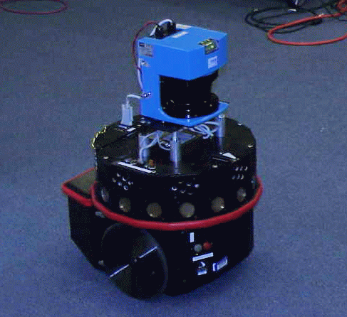
Example: Tracking a Target
The robot must keep
the target in view
The target’s trajectory
is not known in advance
robot
target

Slide 57
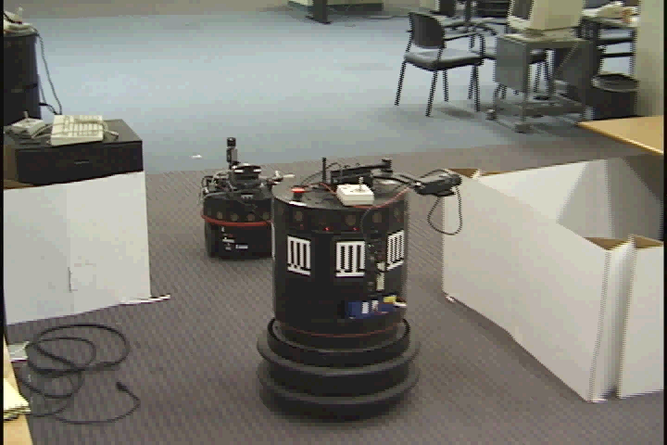
Example: Tracking a Target

Slide 58
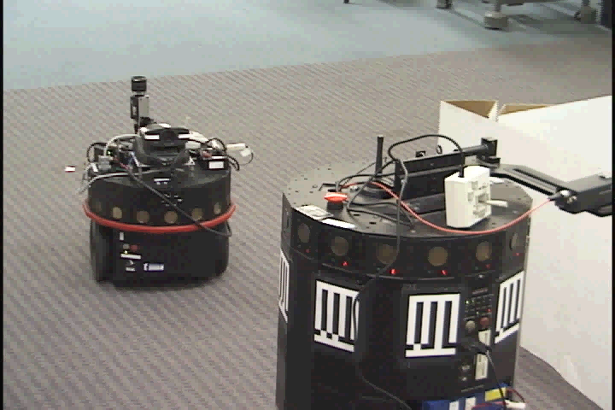
Example: Tracking a Target

Slide 59
Infinite Horizon
In many problems, e.g., the robot
navigation example, histories are
potentially unbounded and the same
state can be reached many times
3
+1
What if the robot lives forever?
2
-1
One trick:
Use discounting to make infinite
Horizon problem mathematically
tractible
1
1
2
3
4

Slide 60
POMDP (Partially Observable Markov Decision Problem)
A sensing operation returns multiple
states, with a probability distribution
Choosing the action that maximizes the
expected utility of this state distribution
assuming “state utilities” computed as
above is not good enough, and actually
does not make sense (is not rational)

Slide 61
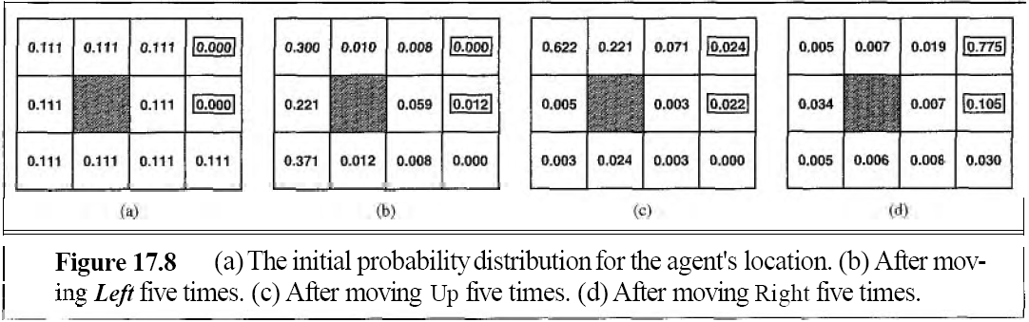
The agent does not necessarily know which state it is in, so it cannot execute the action π(s) recommended for that state.
In POMDPs, the concept is refined somewhat. A belief state b is now a probability distribution over all possible states.
The optimal action depends only on the agent's current belief state.
That is, the optimal policy can be described by a mapping π*(b) from belief states to actions.
It does not depend on the actual state the agent is in. Because the agent does not know its actual state; all it knows is the belief state.

Slide 62
Example: Target Tracking
There is uncertainty
in the robot’s and target’s
positions, and this uncertainty
grows with further motion
There is a risk that the target
escape behind the corner
requiring the robot to move
appropriately
But there is a positioning
landmark nearby. Should
the robot tries to reduce
position uncertainty?

Slide 63
Summary
Decision making under uncertainty
Utility function
Optimal policy
Maximal expected utility
Value iteration
Policy iteration

